Slide 1
Study for Finding CAR 163916570
 | Team Review Criteria - Findings | Related to | Presented by
1 | ·Explain how/If the nonconformity is fully addressed in the analysis | Analysis | Paul Ip
2 | ·Explain how/If the analysis supports the root cause statement
3 | ·Explain how/If the analysis supports the Scope of Nonconformance statement
4 | ·Explain why/If the Corrective Action Plan will prevent the recurrence of the nonconformity | Corrective Action | Paul Ip
5 | ·Explain how/If the containment milestone “stopped the bleeding”
6 | ·Confirm that/If all corrective action milestones are aligned to each item of the corrective action plan
7 | ·Explain how/If the verification milestone confirmed the effective implementation of the corrective action plan | Verification | Kila Yang

Slide 2
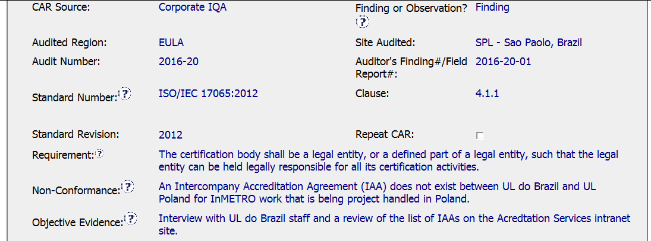
CAR# 163916570 - Background

Slide 3
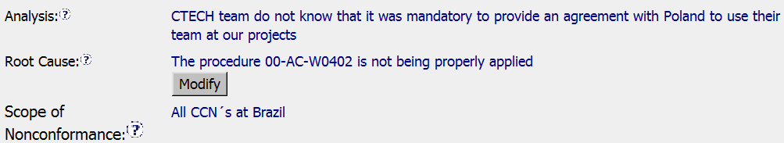
CAR# 163916570
 | Team Review Criteria - Findings | Review Comment
1 | ·Explain how/If the nonconformity is fully addressed in the analysis | Did the Accreditation Services or high level management team involve in this Analysis ? No analysis if any other programs might have the same issue.
2 | ·Explain how/If the analysis supports the root cause statement | The connection is weak between Analysis and Root Cause, it might take further investigation to get the root cause
3 | ·Explain how/If the analysis supports the Scope of Nonconformance statement | Except for InMETRO work, the analysis did not check the other programs and how to determine the scope of nonconformance?
Notes:
Highlight key points for below criteria:
•Explain how/If the nonconformity is fully addressed in the analysis
•Explain how/If the analysis supports the root cause statement
•Explain how/If the analysis supports the Scope of Nonconformance statement

Slide 4
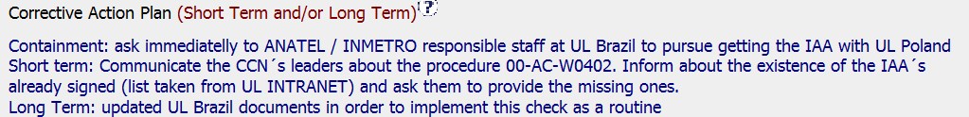
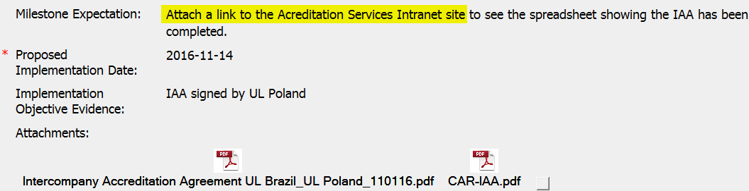
CAR# 163916570
4 | ·Explain why/If the Corrective Action Plan will prevent the recurrence of the nonconformity | Containment & Short term action fully address this CAR.
5 | ·Explain how/If the containment milestone “stopped the bleeding” | IAA has signed by UL Poland. It will be better if the link for AS intranet site or snap shoot is provided.
6 | ·Confirm that/If all corrective action milestones are aligned to each item of the corrective action plan | The milestones contains the elements which states in the corrective action plan
http://intranet.ul.com/en/Tools/DeptsServs/AccreditationServs/_layouts/xlviewer.aspx?id=/en/Tools/DeptsServs/AccreditationServs/Documents/Intercompany%20%20Accreditation%20Agreements%2025%20Apr%202017.xlsx&Source=http%3A%2F%2Fintranet%2Eul%2Ecom%2Fen%2FTools%2FDeptsServs%2FAccreditationServs%2FDocuments%2FForms%2FAllItem
Notes:
Highlight key points for below criteria:
•Explain why/If the Corrective Action Plan will prevent the recurrence of the nonconformity
•Explain how/If the containment milestone “stopped the bleeding”
•Confirm that/If all corrective action milestones are aligned to each item of the corrective action plan

Slide 5
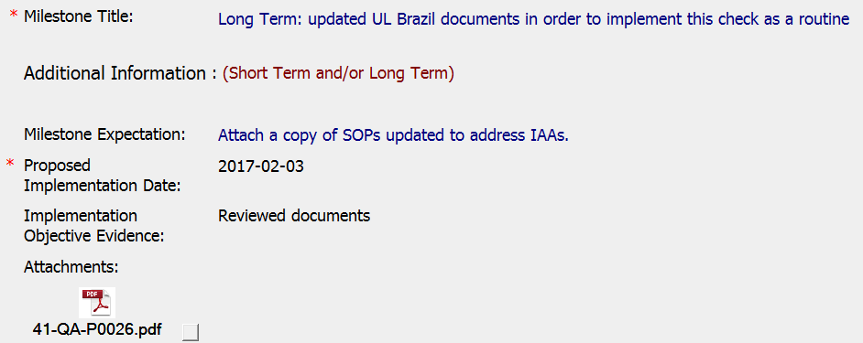
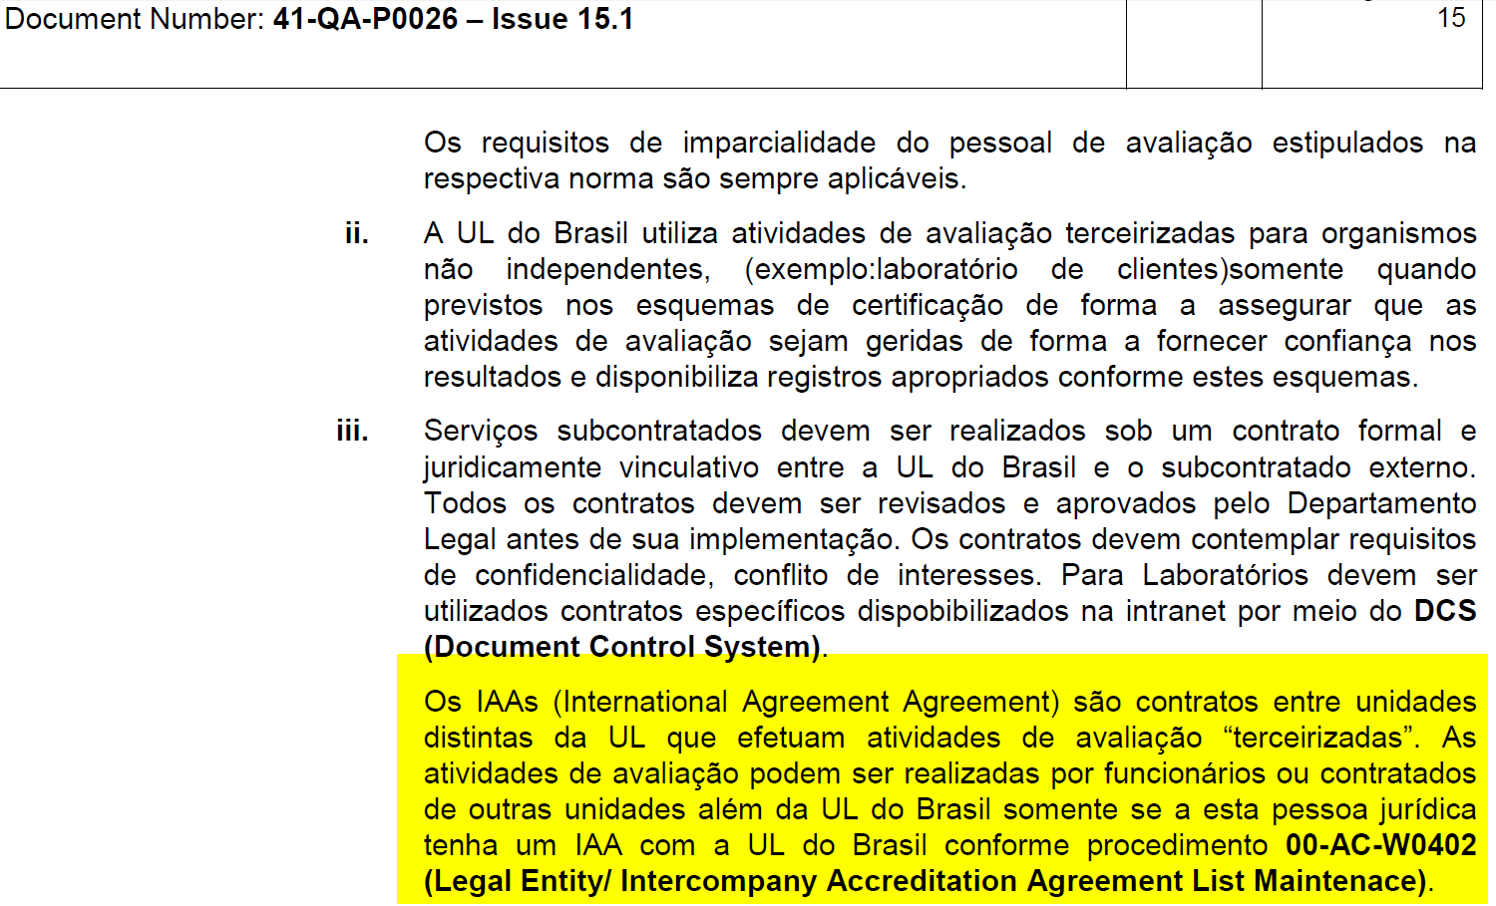
CAR# 163916570
7 | ·Explain how/If the verification milestone confirmed the effective implementation of the corrective action plan | Local document 41-QA-P0026 section 6.2.2 iii updated to make sure effective implement
Notes:
Highlight key points for below criteria:
•Explain how/If the verification milestone confirmed the effective implementation of the corrective action plan

Slide 6
CAR# 163916570 – CAR Review Criteria Check
CAR Review Criteria | Fully | Partially | Not at all | N/A
•Is the nonconformity fully addressed in the analysis? |  | X
•Does the analysis support the root cause statement? |  |  | X
•Does the analysis support the Scope of Nonconformance statement |  |  | X
•Will the Corrective Action Plan prevent recurrence of the nonconformity? | X
•Did the containment milestone “stop the bleeding”? | X
•Are corrective action milestones aligned to each item of the corrective action plan? | X
•Did the verification milestone confirm the effective implementation of the corrective action plan? | X

Slide 7
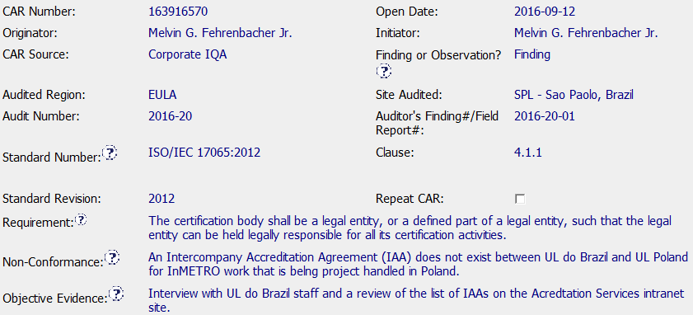
CAR 163916570 FINDING

Slide 8
CAR 163916570 FINDING
Explain how/if the nonconformity is fully addressed in the analysis. (Tony)
It was partially addressed. It needs at least one more why to explain the reason the CTECH team did not know the requirements for an IAA. Is there a specific SOP that they should be using? The analysis does not address the actual function that UL Poland is performing for UL Brasil. How do we know that a similar issue is not happening on a different Industry/BU in Brasil. It almost seems that they added a root cause.
In addition, this Analysis is missing the actual stakeholders who participated in the discussion.
2. Explain how/if the analysis supports the root cause statement. (Tovia)
The analysis does not support the root cause statement, it is simply a restatement of the fact that the team did not do what was required.
More analysis is needed.

Slide 9

CAR 163916570 FINDING
Explain how/if the analysis supports the Scope of Nonconformance statement. (Michelle)
There was no discussion about how the scope was determined, but the scope was determined to be all CCNs in Brazil.
4. Explain why/if CA Plan will prevent the recurrence of the nonconformity. (Tony)
I believe that the CAP is partially effective. I agree that by communicating with all of the Operation Leaders in Brasil the requirements of the IAA and providing a reference to 00-AC-W0402, and by revising the local Quality Manual (41-QA-P0026) to always verify whether an IAA exists, prior to sub-contracting the work it will help Operations remember.
The only thing I would add is that the CAR did not contain an Owner’s Verification milestone to indicate the effectiveness of the CAP.

Slide 10
CAR 163916570 FINDING
5. Explain how/if the containment milestone "stopped the bleeding“. (Tony)
I don't believe that the Milestone named "Containment" was the real containment. This milestone mainly achieved the corrective action. The milestone “Short Term" did a better job of stopping the bleeding, by communicating the requirements to all of the Operation Leaders in Brasil, as well as referencing the requirement to have IAAs.
6. Confirm that/If all CA milestones are aligned to each item of the corrective action plan. (Jeff)
MS1: Fully - Containment: IAA Contract Secured
MS2: Partially - Short Term: Stakeholders notified regarding IAA requirements of 00-AC-W0402. Request made for lists of missing IAAs to be returned. [List of missing IAAs not provided in OE. Should there have been another Milestone to confirm that the missing IAAs have been received and corrected?]
MS3: Fully - Long Term: 41-QA-P0026 was updated regarding IAA requirement.
MS4: Not at All - Missing Verification Milestone

Slide 11

CAR 163916570 FINDING
7. Explain how/if the verification milestone confirmed the effective implementation of the CA plan. (Michelle)
There was not a verification milestone for this CAR.

